Slide 1
Rider Attachment ratio Boosting & Association Rules & Premium Flow Rate Time Series Analysis
8/6 PA Study Meeting

Slide 2
Content
Boosting Model Results (COPO)
Confusion Matrix
Importance Plot
Association Rules Analysis (COPO)
What is Association Rules? (Support /Confidence/Lift)
Result Plots
First Try (Uni_Linked DataAll)
Time Series Analysis

Slide 3
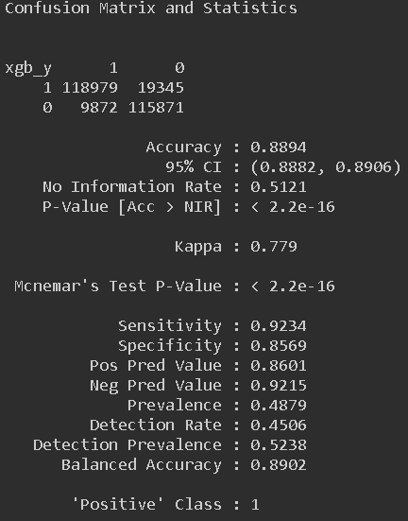
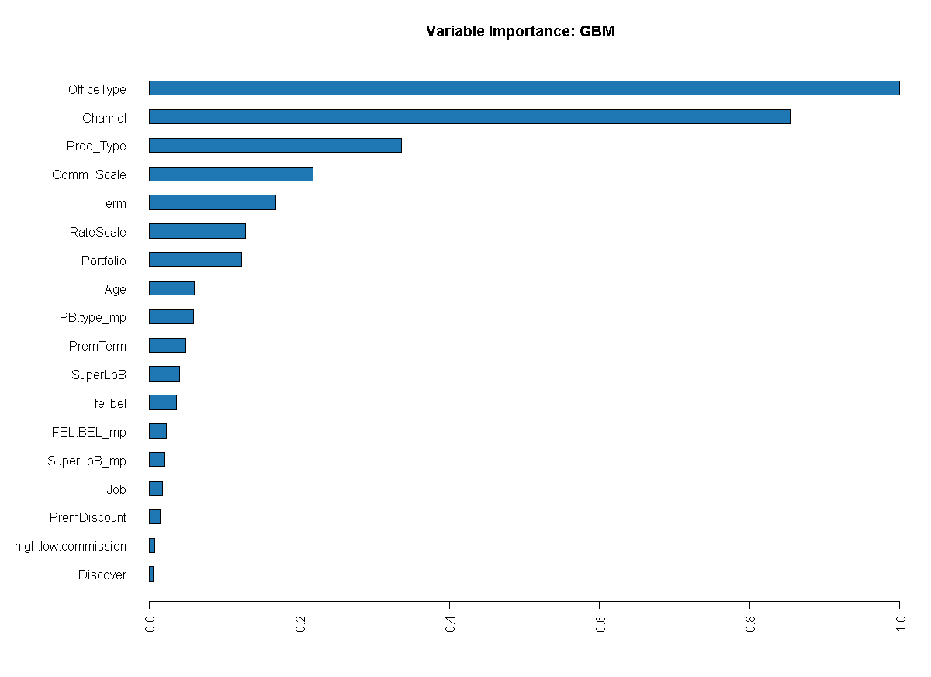
Boosting Model Results (COPO)

Slide 4
Boosting Model Results (COPO)
OfficeType
"AGENT" "BA" "BR" "COLLECT PR" "DM" "STAFF" "WORKSITE"
SuperLoB
"Health (life)" "Life" "Unit-Linked"
Channel
"AAG" "COB" "DBS" "ERO" "FEI" "KTE" "NBA" "NBR" "NDM" "NOT"
PB.Type
"A" "B" "N" "P"
Prod.Type
"A" "C" "D" "E" "H" "I" "K" "M" "N" "O" "R" "T" "V" "W“
Notes:
Prod.Type 把 Prod 按照開頭字母分組

Slide 5
Boosting Model Results (COPO)
Comm_Scale
"0" "1" "2" "3" "4" "5" "6" "7" "8"
High_low Commission
"H" “ L" "N"
Prem Discount
"0" "0.005" "0.01" "0.015" "0.02" "0.025" "0.03" "0.035" "0.045" “0.05" "0.125"
Job
"1" "2" "3" "4" "5" “6" "D"
Notes:
Comm_Scale : 佣金率版次
Prem Discount :傳統型商品保費折扣率

Slide 6
Boosting Model Results (COPO)
Term
"0" "1" "2" "3" "4" "5" "6" "7" "8" "9" "10" "11" "12" "13" "14" "15" "16" "17" "18" "19" "20"
"21" "22" "23" "24" "25" "26" "27" "28" "29" "30" "55" "60" "65" "75" "99"
Discover
"0" "1“
FEL / BEL
"HB" "LB" "LF" "NN“
PremTerm
"1" "2" "3" "5" "6" "7"
Notes:
Term : 年次
PremTerm : 繳費年期

Slide 7



2. Association Rules Analysis
Support
(假設今天共有100組客人光顧，其中同時購買電腦與防毒軟體的有10組，則Support為10%)
Confidence
(假設電腦對防毒軟體的Confidence為60%，代表購買電腦的顧客中有60%也購買防毒軟體)
Lift
(先購買電腦對購買防毒軟體的機率的提升作用)

Slide 8
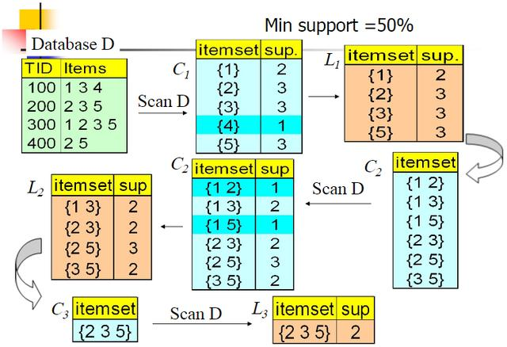
2. Association Rules Analysis

Slide 9
2. Association Rules Analysis
Standard：
Support > 6%
3< len <5
Target：
Have rider

Slide 10
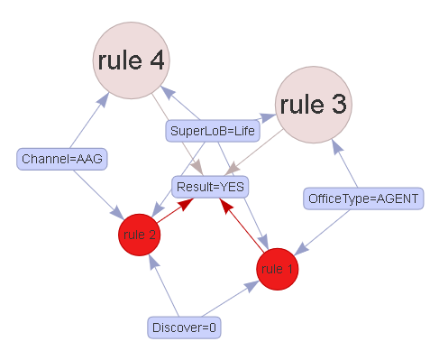
2. Association Rules Analysis

Slide 11
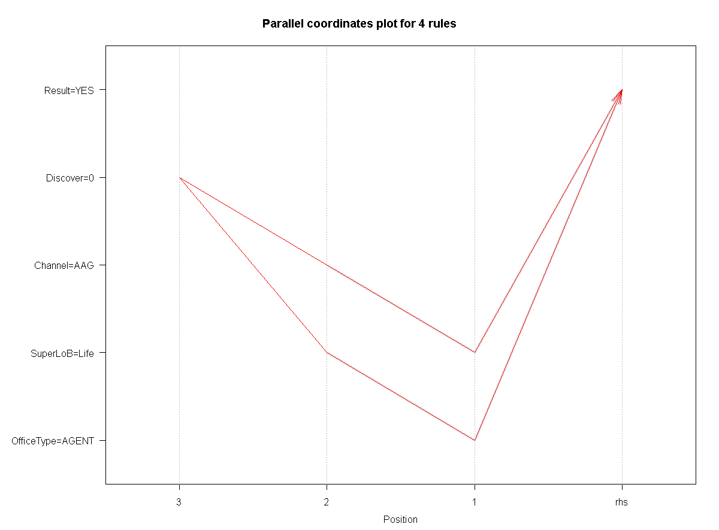
2. Association Rules Analysis

Slide 12
2. Association Rules Analysis
Standard：
Support > 10%
3< len <5
Target：
Have rider

Slide 13
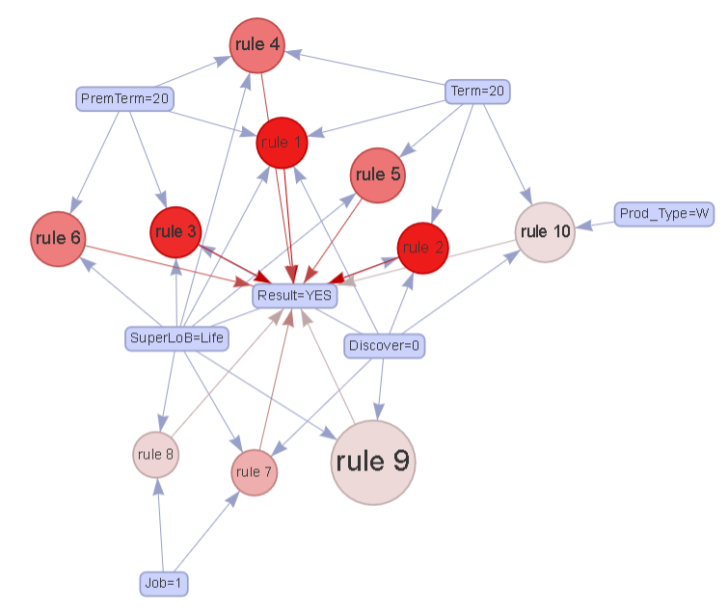
2. Association Rules Analysis (Under Agent )

Slide 14
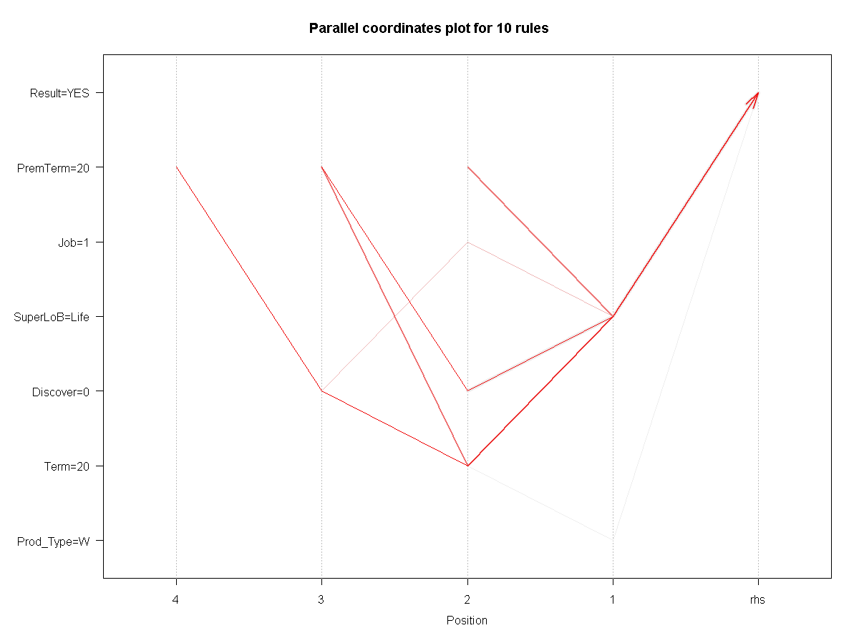
2. Association Rules Analysis (Under Agent )

Slide 15
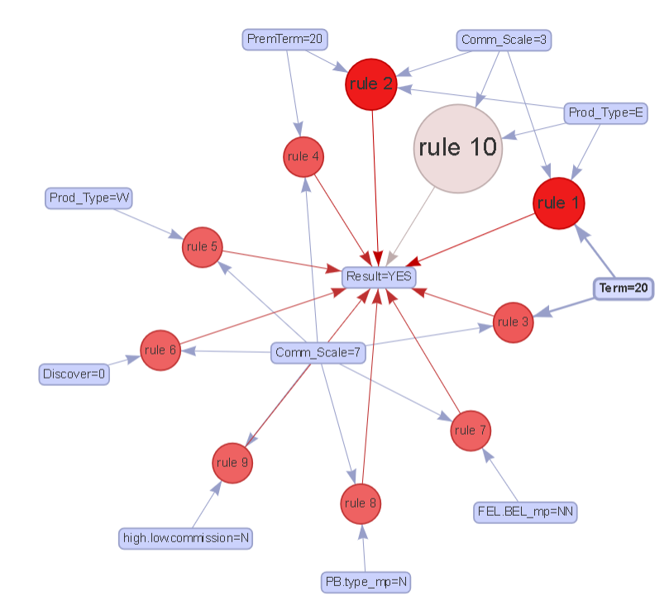
2. Association Rules Analysis (Under Agent/Life)

Slide 16
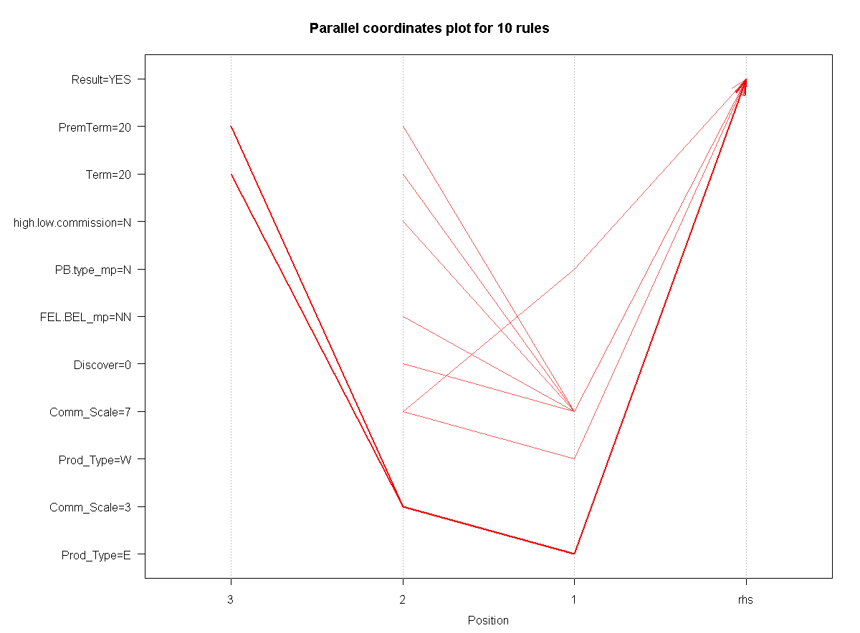
2. Association Rules Analysis (Under Agent /life)

Slide 17
3. Future Goals
Time Series Analysis
Impluse Response：Whether have Lead-Lag effect between variables.
Stability Test： Whether variables in the same time structure.
Time Series Model Fit

Slide 18
3. First Try : Univariate Time Series Analysis

